Slide 1
PROJECT TITLE...
STUDENT PORTFOLIO

Slide 2
Student Details
Name: Tahoora Mariyam . J
Course: B.Sc Data Science
Register No: 31224U48052
NMID: astvu31231224u48052
College: Islamiah Women's Arts and Science College, Thiruvalluvar University

Slide 3
Agenda
1. Problem Statement
2. Project Overview
3. End Users
4. Tools & Technologies
5. Portfolio Design & Layout
6. Features & Functionality
7. Results & Screenshots
8. Conclusion
9. GitHub Link

Slide 4
Problem Statement
Students often lack a single, professional place to present academics, skills, and achievements.
Traditional resumes are static and can’t demonstrate interactivity, design, or navigation.
Teachers and recruiters prefer a quick, structured overview with clear sections and links.
Mobile-friendly, accessible portfolios are needed for easy sharing and review.
Goal: Build a modern, readable, and responsive portfolio showcasing identity and strengths.

Slide 5
Project Overview
A personal portfolio website for Tahoora Mariyam J present academics and interests.
Built with HTML, CSS, and JavaScript for responsiveness and interactivity.
Section: About Me, Skills, Achievements & Hobbies, Ambition, Projects, Contact.
Dark theme with clean typography, badges, and cards for easy scanning.
Fully responsive – works on desktop, laptop and mobile.

Slide 6
End Users
Students – To present achievements, skills, and goals.
Teachers/Professors – To evaluate coursework, growth, and projects.
Recruiters – To quickly assess technical foundations and soft skills.
Peers/Collaborators – To discover interests and explore teamwork opportunities.

Slide 7
Tools & Technologies
HTML5 – Semantic structure and accessible content.
CSS3 – Responsive grid, dark theme, cards, badges, and subtle shadows.
JavaScript – Smooth scrolling, scroll-reveal, active link highlight, mobile menu.
CodePen – Building and testing during development.

Slide 8
Portfolio Design & Layout
Sticky header with accessible navigation and section anchors.
Hero with name, course, call-to-action buttons, and profile placeholder.
About: concise bio + timeline + interest tags.
Skills: technical and soft skills represented as badges.
Achievements &Hobbies: card-based list for quick reading.
Projects: highlights of tools and features used to build this portfolio.
Ambition: personal story that connects to becoming a Data Scientist.
Contact: email and LinkedIn link for opportunities.

Slide 9
Features & Functionality
Responsive layout across mobile, tablet, and desktop.
Smooth scrolling and active link highlight for orientation.
Scroll-reveal animations for engaging reading experience.
Mobile menu toggle and 'Back to Top' button for navigation.
Simple structure for future additions (resume, projects, blog).

Slide 10

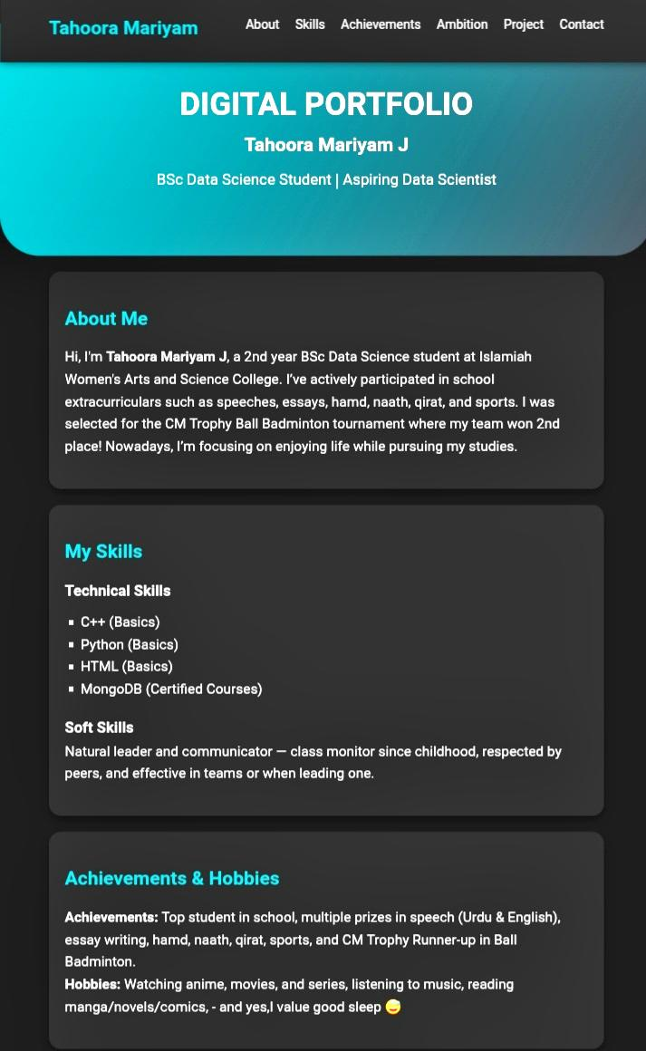
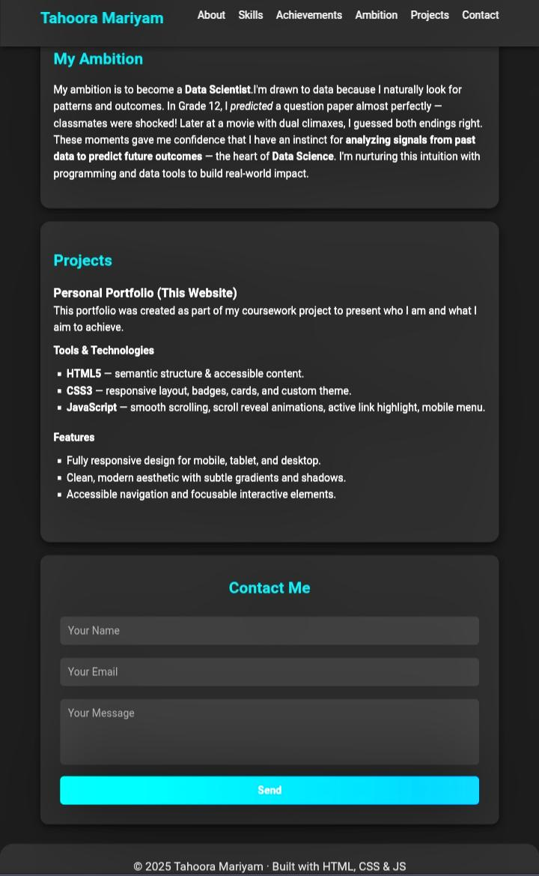
Results & Screenshots

Slide 11
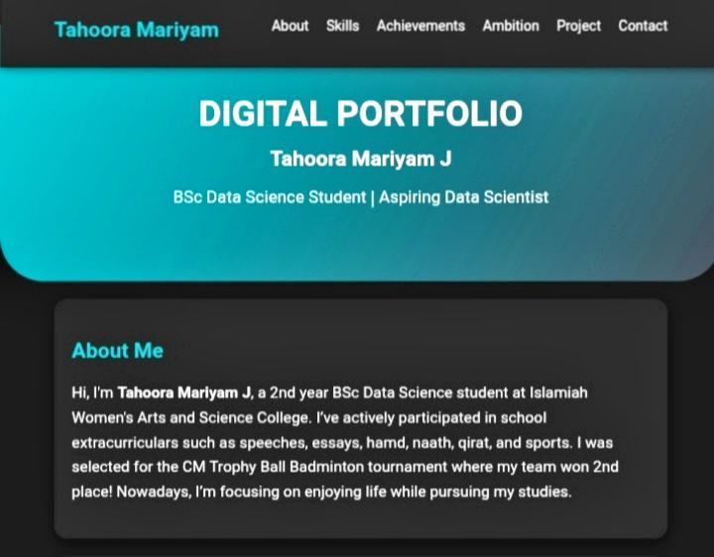
About Me

Slide 12
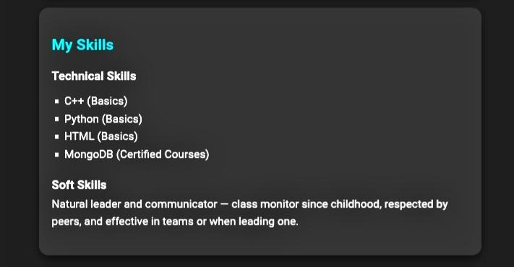
My Skills

Slide 13
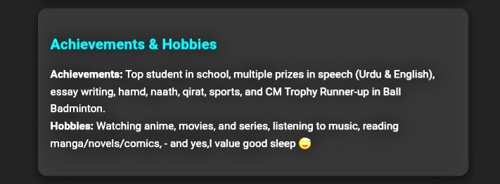
Achievements & Hobbies

Slide 14
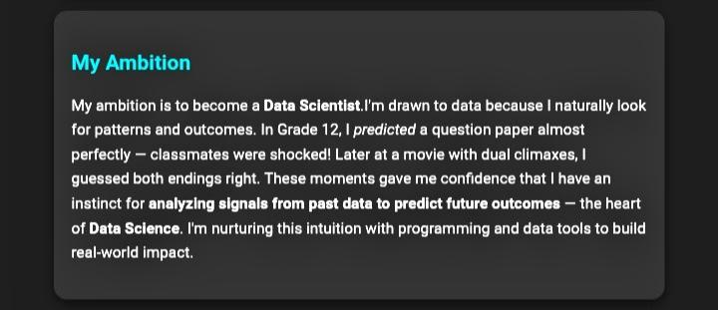
My Ambition

Slide 15
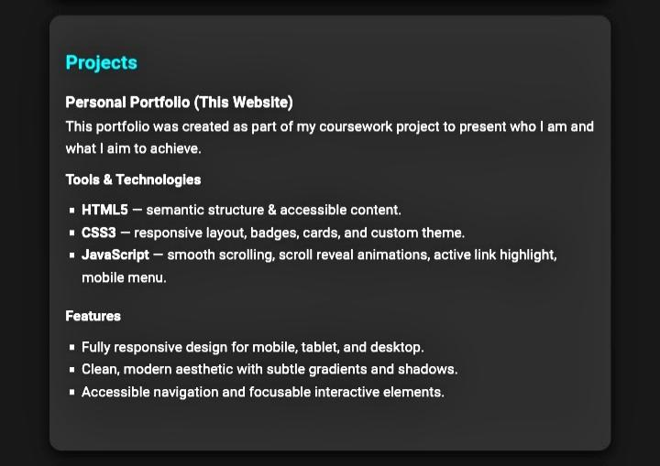
My Project

Slide 16
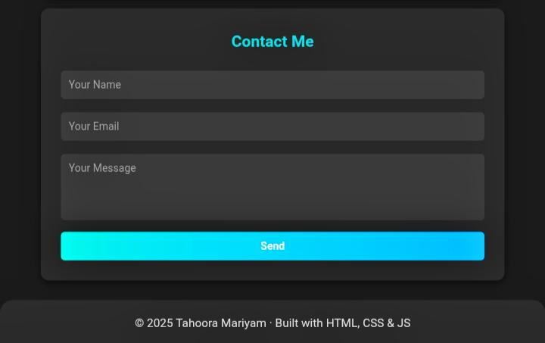
Contact Me

Slide 17
Conclusion
A clean, modern portfolio that clearly communicates identity and strengths.
Demonstrates practical use of HTML, CSS, and JavaScript for a real deliverable.
Organizes academics, achievements, and goals for teachers and recruiters.
Future-ready: easy to add resume download, more projects, and blog posts.
Supports the long-term ambition to become a Data Scientist.

